Slide 1
Deep Learning

Slide 2


Slide 3
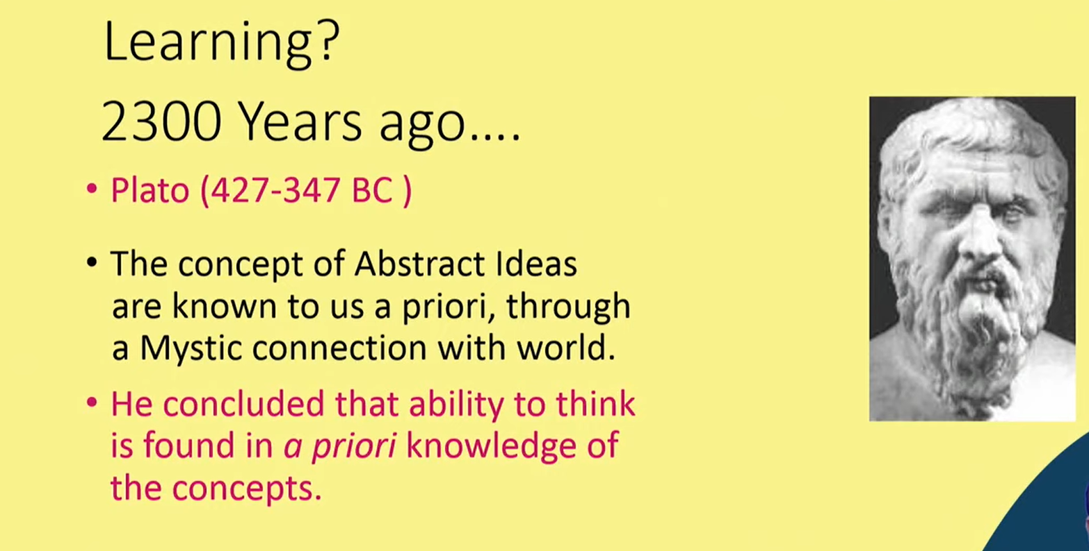

Slide 4
Historical trends in deep learning
Deep Learning has a long and rich history but has gone by many names reflecting different philosophical viewpoints, and has waxed in popularity.
Deep Learning has become more useful as the amount of available training data has increased.
Deep Learning models have grown in size over time as computer infrastructure for deep learning has improved.
Deep Learning has solved increasingly complicated applications with increasing over time.

Slide 5
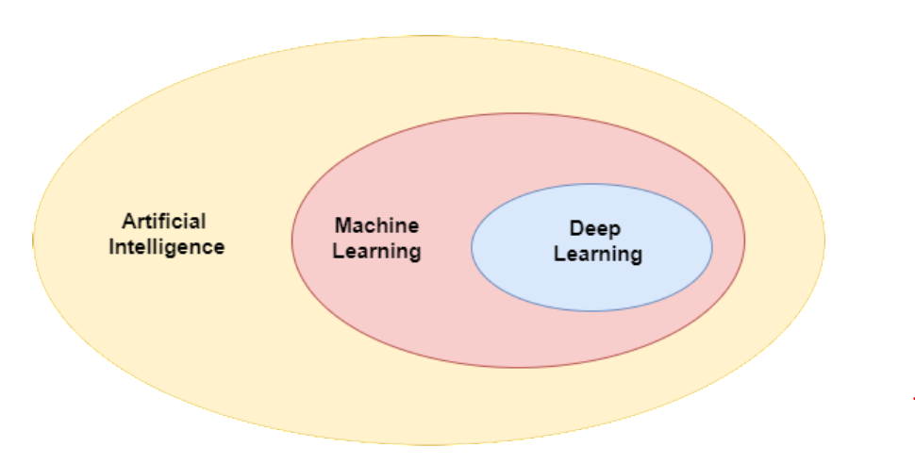
Machine Learning vs Deep Learning
Artificial Intelligence: Artificial Intelligence enables machines to mimic human brains. Artificial Intelligence is a technology that makes machines behave like humans meaning to act like humans, make a pattern like humans, and take decisions like humans. It makes machines automated and produces decision ability in machines like humans. Amazon Alexa and Google Assistant is the proper example of Artificial Intelligence.
Machine Learning (ML): Algorithms that learn from structured data to predict outputs and discover patterns in that data.
Deep Learning (DL): Algorithms based on highly complex neural networks that mimic the way a human brain works to detect patterns in large unstructured data sets.

Slide 6
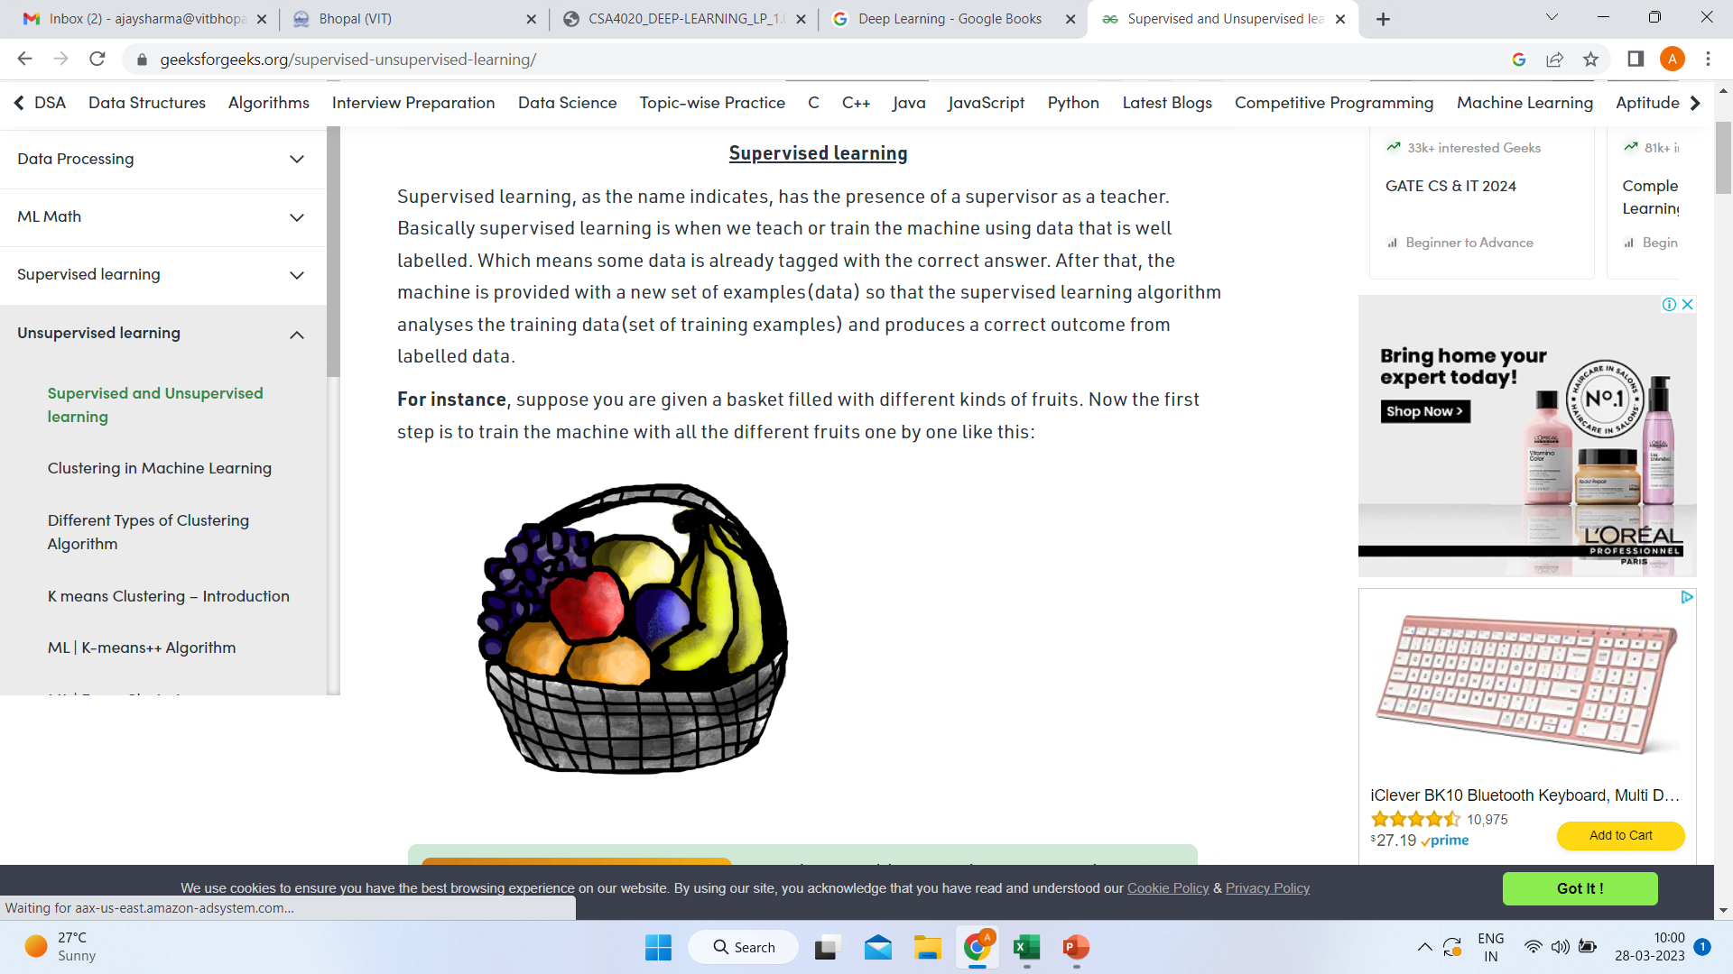
Learning methods

Slide 7
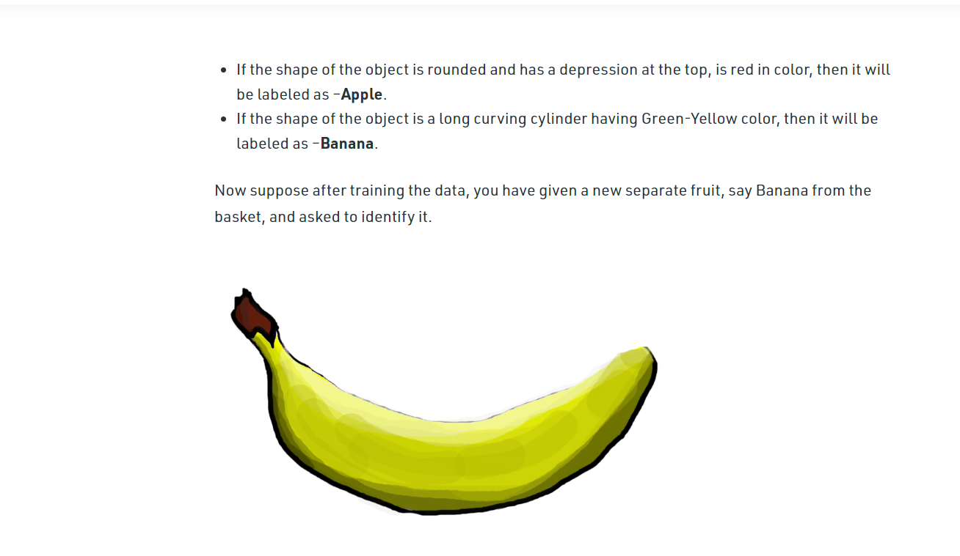

Slide 8
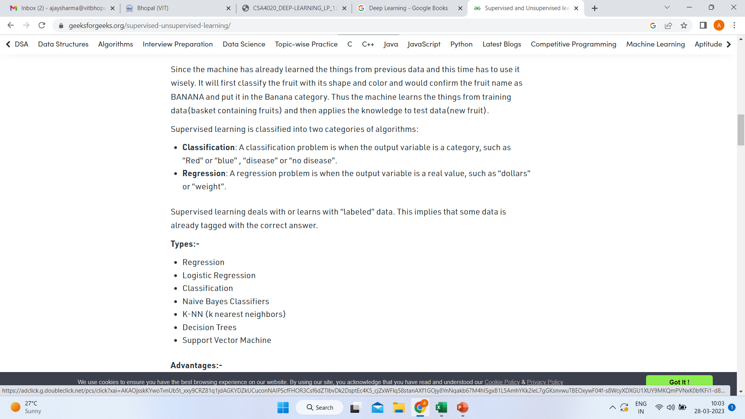

Slide 9
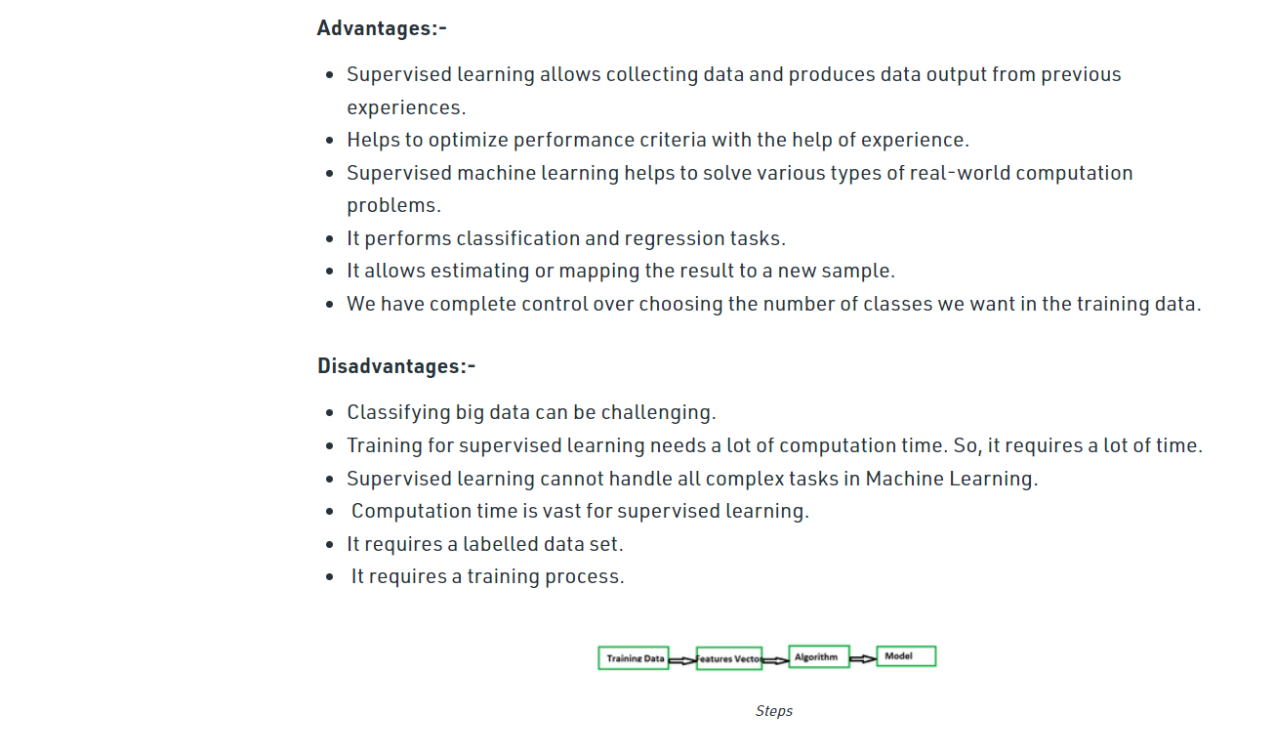

Slide 10
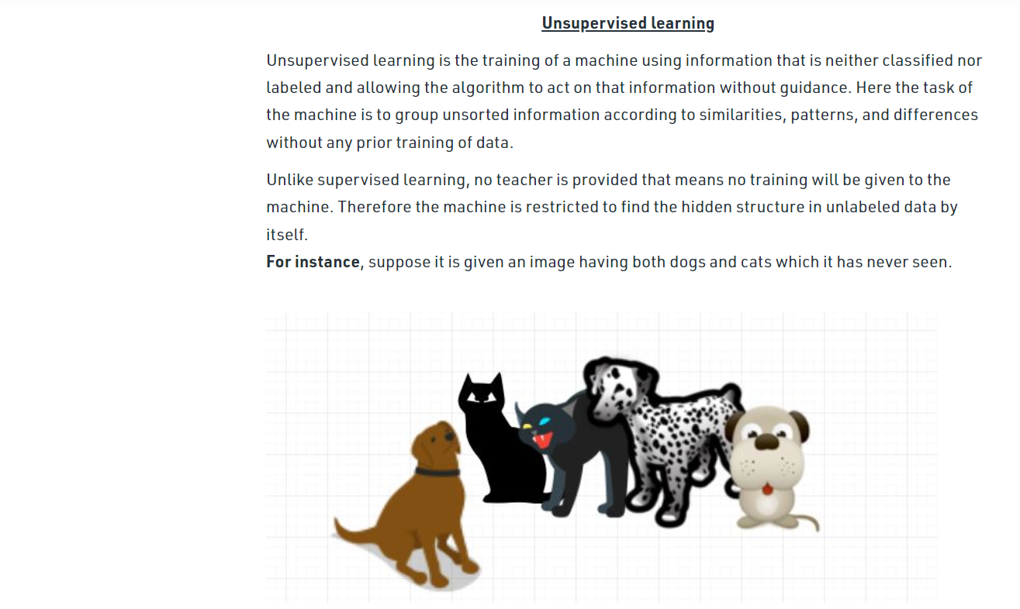

Slide 11
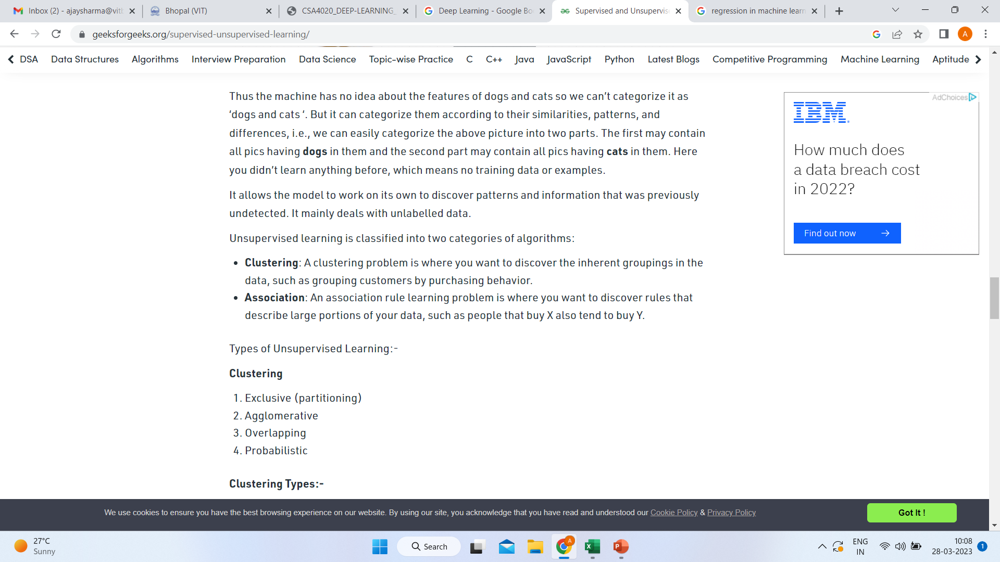

Slide 12
